Slide 1
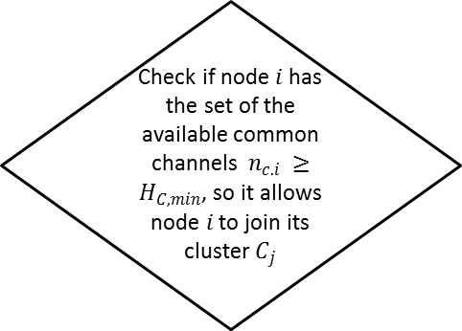
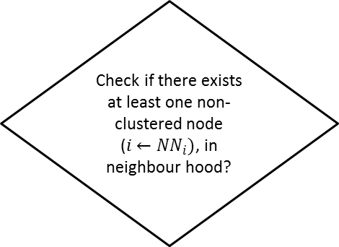
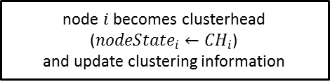
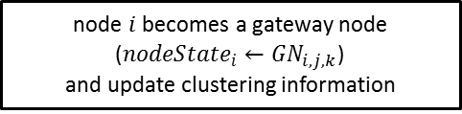
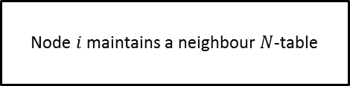
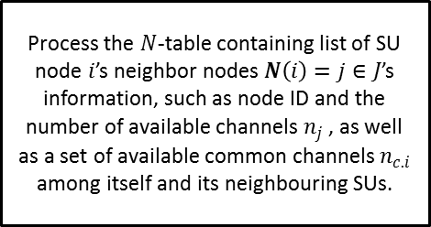

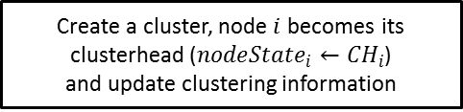

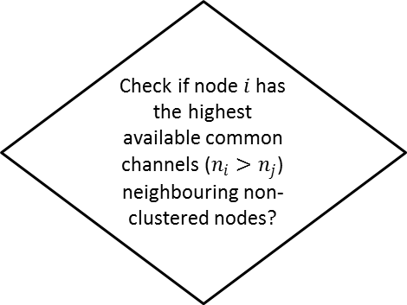
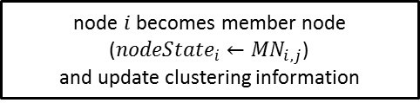
Start
Node $i$ maintains a neighbour $N$-table
Process the $N$-table containing list of SU node $i$’s neighbor nodes $N\left(i\right)=j∈J$’s information, such as node ID and the number of available channels $n_{j}$, as well as a set of available common channels $n_{c.i}$ among itself and its neighbouring SUs.
Check if there exists at least one non-clustered node ($i←{NN}_{i})$, in neighbour hood?
Check if node $i$ has the set of the available common channels $n_{c.i} ≥H_{C,min}$, so it allows node $i$ to join its cluster $C_{j}$
No
No
Yes
Yes
Check if node $i$ has the highest available common channels ($n_{i}>n_{j}$) neighbouring non-clustered nodes?
node $i$ becomes member node ($n{odeState}_{i}←{MN}_{i,j}$)
and update clustering information
Create a cluster, node $i$ becomes its clusterhead ($n{odeState}_{i}←{CH}_{i}$)
and update clustering information
Check if there exists at least one member node ($i←{MN}_{i,j})$, in neighbour hood?
Yes
node $i$ becomes clusterhead ($n{odeState}_{i}←{CH}_{i}$)
and update clustering information
Yes
Check if member node $i$ of cluster $j$ has the number of hops $n_{h.i}=N_{H,min}$ from cluster $k$
No
Yes
node $i$ becomes a gateway node ($n{odeState}_{i}←{GN}_{i,j,k}$)
and update clustering information
End

